Slide 1
Factory Automation and Control Methods
Lecture 5: Industrial Control Systems
Daro VAN
Paragon International University
Faculty of Engineering
Department of Industrial Engineering

Slide 2
Outline
Process industries versus discrete manufacturing Industries
Level of automation
Variables and parameters in the two industries
Continuous Versus Discrete Control
Continuous control systems
Discrete control systems
Computer Process Control
Control requirements
Capabilities of computer control
Forms of computer process control

Slide 3
What is industrial control?
“Industrial control is defined here as the automatic regulation of unit operations and their associated equipment, as well as the integration and coordination of the unit operations in the
larger production system.”
Note: unit operations in this class refers to manufacturing processes.

Slide 4
Process Industries Versus Discrete Manufacturing Industries
Industries and their production operations were divided into two basic categories:
Process industries: perform their production operations on amounts of materials, because the materials tend to be liquids, gases, powders, etc.
Discrete manufacturing industries: perform their operations on quantities of materials, because the materials tend to be discrete parts or productions.

Slide 5
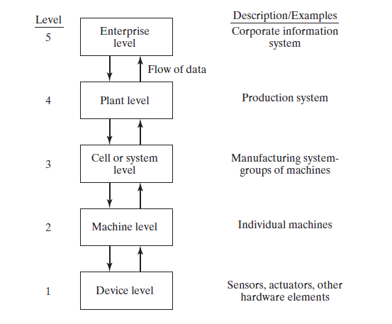
Process Industries Versus Discrete Manufacturing Industry
Levels of Automation in the Two Industries

Slide 6
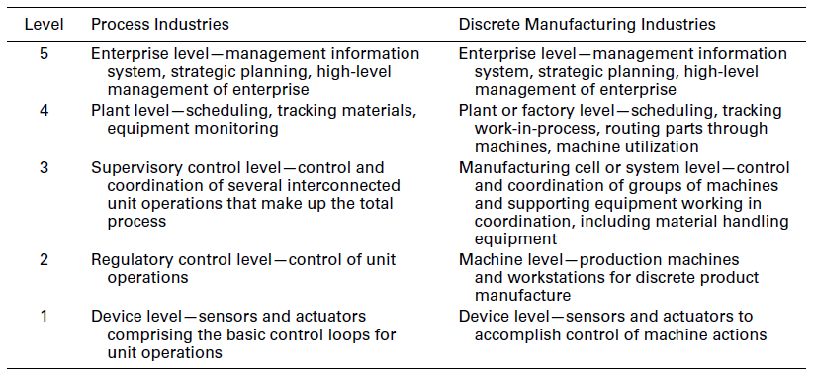
Process Industries Versus Discrete Manufacturing Industry
Levels of Automation in the Two Industries

Slide 7
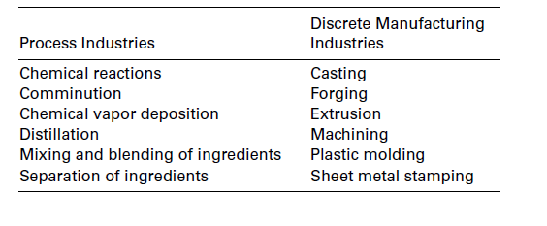
Process Industries Versus Discrete Manufacturing Industry
Variables and parameters in the two industries
In the process industries, the variables and parameters of interest tend to be continuous, whereas in discrete manufacturing, they tend to be discrete.

Slide 8
Process Industries Versus Discrete Manufacturing Industry
Variables and parameters in the two industries
A continuous variable (or parameter) is one that is uninterrupted as time proceeds, at least during the manufacturing operation.
Ex. force, temperature, flow rate, pressure, and velocity.
A discrete variable (or parameter) is one that can take on only certain values within a given range. Ex. limit switch open or closed, motor on or off, and work part present or not present in a fixture

Slide 9
Continuous Versus Discrete Control
Process industries tend to emphasize the control of continuous variables and parameters.
Manufacturing industries produce discrete parts and products, and their controllers tend to emphasize discrete variables and parameters.
There are also two basic types of control:
Continuous control, in which the variables and parameters are continuous or analog
Discrete control, in which the variables and parameters are discrete.

Slide 10
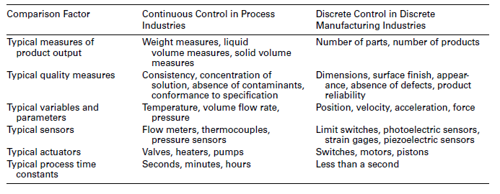
Continuous Versus Discrete Control
Comparison between continuous and discrete control

Slide 11
Continuous Versus Discrete Control
Continuous control systems
In continuous control, the usual objective is to maintain the value of an output variable at a desired level.
There are several ways to achieve the control objective in continuous process control systems such as
Regulatory control
Feedforward control
Steady-state optimization
Adaptive control
……

Slide 12
Continuous Versus Discrete Control
Continuous control systems
Regulatory Control: the objective is to maintain process
performance at a certain level or within a given tolerance band of that level.
Applications: appropriate when the performance attribute is some measure of product quality, and it is important to keep the quality at the specified level or within a specified range.

Slide 13
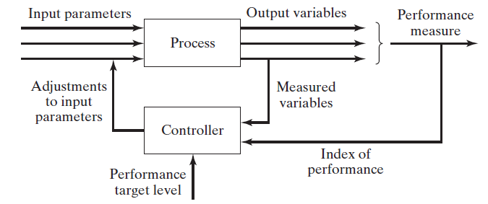
Continuous Versus Discrete Control
Continuous control systems
Note: The trouble with regulatory control (and also with a simple feedback control loop) is that compensating action is taken only after a disturbance has affected the process output. An error must be present for any control action to be taken.

Slide 14
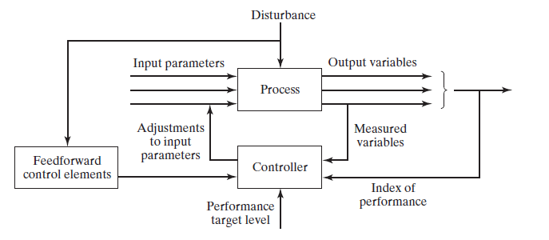
Continuous Versus Discrete Control
Continuous control systems
Feedforward Control: anticipate the effect of disturbances that will upset the process by sensing them and compensating for
them before they affect the process.
Note: In the ideal case, the compensation is completely effective. However, complete compensation is unlikely because of delays and/or imperfections in the feedback measurements, actuator operations,

Slide 15
Continuous Versus Discrete Control
Continuous control systems
Steady-State Optimization. This term refers to a class of optimization techniques in which the process exhibits the following characteristics:
there is a well-defined index of performance, such as product cost, production rate, or process yield.
the relationship between the process variables and the index of performance is known
the values of the system parameters that optimize the index of performance can be determined mathematically.
When these characteristics apply, the control algorithm is designed to make adjustments in the process parameters to drive the process toward the optimal state.

Slide 16
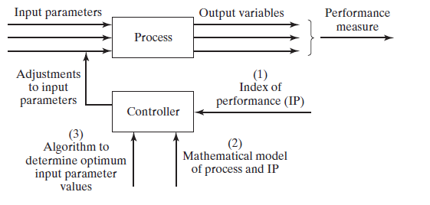
Continuous Versus Discrete Control
Continuous control systems
Steady-state (open loop) optimal control

Slide 17
Continuous Versus Discrete Control
Continuous control systems
Steady-state optimal control operates as an open-loop system. It works successfully when there are no disturbances. When such disturbances are present in the application, a self-correcting form of optimal control can be used, called
adaptive control.

Slide 18
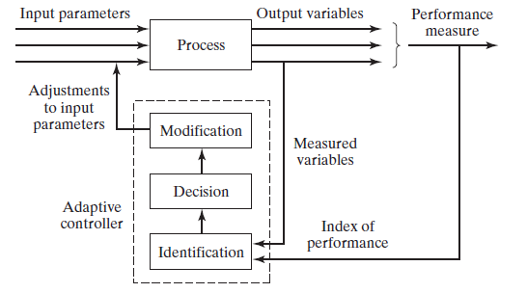
Continuous Versus Discrete Control
Continuous control systems
Adaptive Control

Slide 19
Continuous Versus Discrete Control
Discrete control systems
In discrete control, the parameters and variables of the system are changed at discrete moments in time, and the changes involve variables and parameters that are also discrete, typically binary (ON/OFF).
The changes are defined in advance by means of a program of instructions, for example, a work cycle program. The changes are executed either because the state of the system has changed or because a certain amount of time has elapsed.

Slide 20
Continuous Versus Discrete Control
Discrete control systems
These two cases can be distinguished as
Event-driven changes: executed by the controller in response to some event that has caused the state of the system to be altered.
Ex. Counting parts moving along a conveyor, A robot loads a work part into the fixture,…
Time-driven changes: executed by the control system either at a specific point in time or after a certain time lapse has occurred.
Ex. Heat-treating operations, operation of a washing machine,

Slide 21
Computer Process Control
Control requirement
A real-time controller is a controller that is able to respond to the process within a short enough time period that process performance is not degraded.
Real-time control usually requires the controller to be capable of multitasking, which means coping with multiple tasks concurrently without the tasks interfering with one another.

Slide 22
Computer Process Control
Control requirement
There are two basic requirements that must be managed by the controller to achieve real-time control:
Process-initiated interrupts : The controller must be able to respond to incoming signals from the process. The computer may need to interrupt execution of a current program to service a higher-priority need of the process.
A process-initiated interrupt is often triggered by abnormal operating conditions, indicating that some corrective action must be
taken promptly.

Slide 23
Computer Process Control
Control requirement
Timer-initiated actions: The controller must be capable of executing certain actions at specified points in time. Timer-initiated actions can be generated at regular time intervals.
Ex.
Scanning sensor values from the process at regular sampling intervals
Turning on and off switches, motors, and other binary devices associated with the process at discrete points in time during the work cycle
Displaying performance data on the operator’s console at regular times during a production run
Recomputing optimal process parameter values at specified times.

Slide 24
Computer Process Control
Control requirement
These two requirements correspond to the two types of changes mentioned previously in the context of discrete control systems:
Event-driven changes,
Time-driven changes

Slide 25
Computer Process Control
Control requirement
In addition to these basic requirements, the control computer must also deal with other types of interruptions and events. These include the following:
Computer commands to process: In addition to receiving incoming signals from the process, the control computer must send control signals to the process to accomplish a corrective action. These output signals may actuate a certain hardware device or readjust a set point in a control loop.

Slide 26
Computer Process Control
Control requirement
System- and program-initiated events
A system-initiated event involves communications among computers and peripheral devices linked together in a network.
In these multiple computer networks, feedback signals, control commands, and other data must be transferred back and forth among the computers in the overall control of the process.

Slide 27
Computer Process Control
Control requirement
Operator-initiated events: Finally, the control computer must be able to accept input from operating personnel. Operator-initiated events include:
(1) entering new programs;
(2) editing existing programs;
(3) entering customer data, order number,
or startup instructions for the next production run;
(4) requesting process data; and
(5) calling for emergency stops.

Slide 28
Computer Process Control
Capabilities of computer control
The above requirements can be satisfied by providing the controller with certain capabilities that allow it to interact on a real-time basis with the process and the operator. These capabilities are
(1) polling
(2) interlocks,
(3) interrupt system, and
(4) exception handling.

Slide 29
Computer Process Control
Capabilities of computer control
Polling :In computer process control, polling refers to the periodic sampling of data that indicates the status of the process.
Issues related to polling include
(1) polling frequency, which is the reciprocal of the time interval between data collections.
(2) polling order, which is the sequence of sampling the different data collection points of the process; and
(3) polling format, which refers to the manner in which the sampling procedure is designed.

Slide 30
Computer Process Control
Capabilities of computer control
Interlocks : An interlock is a safeguard mechanism for coordinating the activities of two or more devices and preventing one device from interfering with the other(s).
In process control, interlocks provide a means by which the controller is able to sequence the activities in a work cell, ensuring that the actions of one piece of equipment are completed before the next piece of equipment begins its activity.

Slide 31
Computer Process Control
Capabilities of computer control
There are two types of interlocks, input interlocks and output interlocks, where input and output are defined relative to the controller.
An input interlock is a signal that originates from an external device (e.g., a limit switch, sensor, or production machine) that is sent to the controller.

Slide 32
Computer Process Control
Capabilities of computer control
Input interlocks are used for either of the following functions:
To proceed with the execution of the work cycle program.
Ex. the production machine communicates a signal to the controller that it has completed its processing of the part. This signal constitutes an input interlock indicating that the controller can now proceed to the next step in the work cycle, which is to unload the part.
2. To interrupt the execution of the work cycle program.
Ex. while unloading the part from the machine, the robot accidentally drops the part. The sensor in its gripper transmits an interlock signal to the controller indicating that the regular work cycle sequence should be interrupted until corrective action is taken.

Slide 33
Computer Process Control
Capabilities of computer control
An output interlock is a signal sent from the controller to some external device. It is used to control the activities of each external device and to coordinate their operation with that of the other equipment in the cell.
For example, an output interlock can be used to send a control signal to a production machine to begin its automatic cycle after the
work part has been loaded into it.

Slide 34
Computer Process Control
Capabilities of computer control
Interrupt System :Closely related to interlocks is the interrupt system. There are occasions when it becomes necessary for the process or operator to interrupt the regular controller operation to deal with more pressing matters.
All computer systems are capable of being interrupted, if nothing else, by turning off the power.

Slide 35
Computer Process Control
Capabilities of computer control
Exception Handling :In process control, an exception is an event that is outside the normal or desired operation of the process or control system.
Examples of events that may invoke exception handling routines include product quality problems, process variables operating
outside their normal ranges, shortage of raw materials or supplies necessary to sustain the process, hazardous conditions such as a fire, and controller malfunction

Slide 36
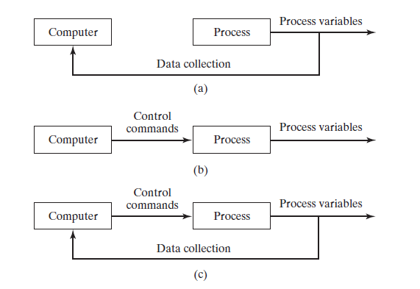
Computer Process Control
Forms of computer process control
There are various ways in which computers can be used to control a process.
Process monitoring
Open-loop control
Closed-loop control

Slide 37
Computer Process Control
Forms of computer process control
Computer process monitoring is one of the ways in which the computer can be interfaced with a process.
It involves the use of the computer to observe the process and associated equipment and to collect and record data from the operation.
The computer is not used to directly control the process. Control remains in the hands of humans who use the data to guide them in managing and operating
the process.

Slide 38
Computer Process Control
Forms of computer process control
The data collected by the computer in computer process monitoring can generally be classified into three categories:
1. Process data : These are measured values of input parameters and output variables that indicate process performance. When the values are found to indicate a problem, the human operator takes corrective action.

Slide 39
Computer Process Control
Forms of computer process control
2. Equipment data: These data indicate the status of the equipment in the process. The data are used to monitor machine utilization, schedule tool changes, avoid machine breakdowns, diagnose equipment malfunctions, and plan preventive maintenance.
3. Product data: Government regulations require certain manufacturing industries to collect and preserve production data on their products. Computer monitoring is the most convenient means of satisfying these regulations. A firm may also want to collect product data for its own use.

Slide 40
Computer Process Control
Forms of computer process control
Direct Digital Control
DDC was certainly one of the important steps in the development
of computer process control.
DDC is a computer process-control system in which certain components in a conventional analog control system are replaced by the digital computer.
With DDC, the computer calculates the desired values of the input parameters and set points, and these values are applied through a direct link to the process, hence the name “direct digital” control.

Slide 41
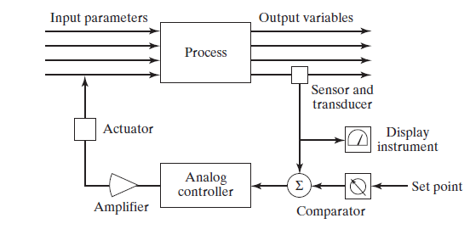
Computer Process Control
Forms of computer process control
Analog Control Loop
Typical hardware components
of the analog control loop
Include:
the sensor and
transducer,
an instrument for displaying the output variable,
some means for establishing the set point of the loop,
a comparator (to compare set point with measured output variable),
the analog controller,
an amplifier, and t
actuator the actuator determines the input parameter to the process.

Slide 42
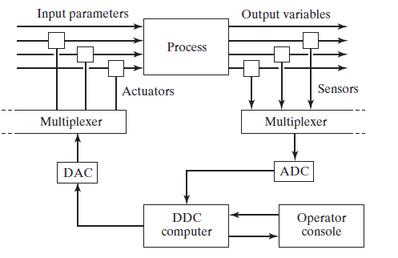
Computer Process Control
Forms of computer process control
Direct Digital Control

Slide 43
Computer Process Control
Forms of computer process control
Direct Digital Control
The opportunities for the control computer were soon recognized, including:
More control options than traditional analog. With digital computer control, more complex control algorithms can be performed than with the conventional control modes used by analog controllers; for example, on/off control or nonlinearities in the control functions can be implemented.
Integration and optimization of multiple loops. This is the ability to integrate feedback measurements from multiple loops and to implement optimizing strategies to improve overall process performance.

Slide 44
Computer Process Control
Forms of computer process control
Direct Digital Control
The opportunities for the control computer were soon recognized, including:
Ability to edit the control programs. Using a digital computer makes it relatively easy to change the control algorithm when necessary by simply reprogramming the computer. Reprogramming an analog control loop is likely to require hardware changes that are more costly and less convenient.

Slide 45
Computer Process Control
Computer Numerical Control and Robotics
CNC is another form of industrial computer control. It involves the use of the computer (again, a microcomputer) to direct a machine tool through a sequence of processing steps defined by a program of instructions specifying the details of each step and their
sequence.
The distinctive feature of CNC is control of the relative position of a tool with respect to the object (work part) being processed. Computations must be made to determine the trajectory that will be followed by the cutting tool to shape the part geometry.
Hence, CNC requires the controller to execute not only sequence control but geometric calculations as well.

Slide 46
Computer Process Control
Computer Numerical Control and Robotics
Closely related to CNC is industrial robotics, in which the joints of a manipulator (robot arm) are controlled to move the end of the arm through a sequence of positions during the work cycle.
As in CNC, the controller must perform calculations during the work cycle to implement motion interpolation, feedback control, and other functions.
In addition, a robotic work cell usually includes other equipment besides the robot, and the activities of the other equipment in the work cell must be coordinated with those of the robot. This coordination is achieved using interlocks.

Slide 47
Computer Process Control
Programmable Logic Controllers and Related Equipment
A programmable logic controller can be defined as a microprocessor-based controller that uses stored instructions
in programmable memory to implement logic, sequencing, timing, counting, and arithmetic control functions for controlling machines and processes.
Today’s PLCs are used for both continuous control and discrete control applications in both the process industries and discrete manufacturing.

Slide 48
Computer Process Control
Programmable Logic Controllers and Related Equipment
A programmable automation controller can be thought of as
a digital controller that combines the capabilities of a personal computer with those of a conventional PLC; specifically, the input/output capabilities of a PLC are combined with the data processing, network connectivity, and enterprise data integration features of a
PC.
A remote terminal unit is a microprocessor-based device that is connected to the process, receiving electrical signals from sensors and converting them into digital data for use by a central control computer; in some cases it also performs a control function for local sections of the process. RTUs often use wireless communications to transmit data, whereas PLCs use hardwired connections.

Slide 49
Computer Process Control
Supervisory Control and Data Acquisition
The term supervisory control and data acquisition (SCADA) emphasizes the fact that such control systems also collect data from the process, which often includes multiple sites distributed over large distances.
The general mode of operation in SCADA is for the remote devices to directly control the various control loops in the system, but these devices can be overridden by the operator at the HMI if that becomes necessary for some reason.
For example, the operator might change the value of a set
point in one of the control loops.

Slide 50
Computer Process Control
Supervisory Control and Data Acquisition
A typical SCADA system consists of the following components:
(1) a central supervisory computer system capable of collecting data from the process and transmitting command signals to the process, (2) a human-machine interface (HMI) that presents the collected data to the system operator(s) and enables them to
send command signals,
(3) distributed PLCs and RTUs that are connected directly to the
process for data acquisition and control, and
(4) a communications network that connects
the central computer to the remote PLCs and RTUs.

Slide 51
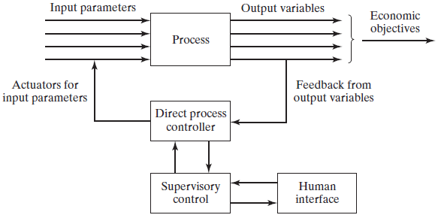
Computer Process Control
Supervisory Control and Data Acquisition

Slide 52
Computer Process Control
Distributed Control Systems
The term distributed control system (DCS) is used to describe a configuration consisting of multiple microcomputers connected
together to share and distribute the process-control workload.

Slide 53
Computer Process Control
Distributed Control Systems
A DCS consists of the following components and features:
Multiple process-control stations located throughout the plant to control the individual loops and devices of the process. PCs, PACs, PLCs, and RTUs are used at these stations.
A central control room equipped with operator stations, where supervisory control of the plant occurs.
(cont… next page)

Slide 54
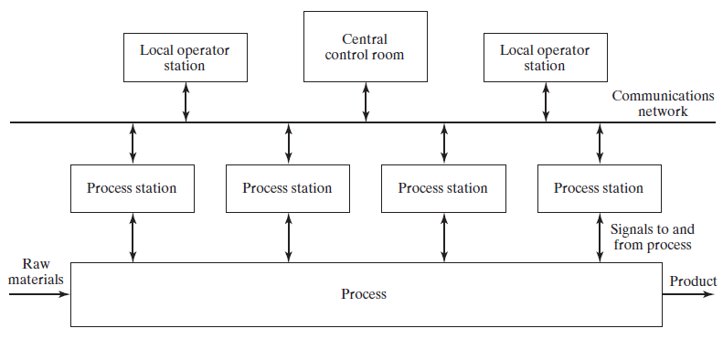
Computer Process Control
Distributed Control Systems

Slide 55
Computer Process Control
Distributed Control Systems
Local operator stations distributed throughout the plant. This provides the DCS with redundancy. If a control failure occurs in the central control room, the local operator stations take over the central control functions. If a local operator station fails, the other local operator stations assume the functions of the failed station.
All process and operator stations interact with each other by means of a communications network, or data highway, as it is often called.

Slide 56
Computer Process Control
Distributed Control Systems
There are a number of benefits and advantages of distributed control:
A DCS can be installed for a given application in a very basic configuration, then enhanced and expanded as needed in the future;
(2) because the system consists of multiple computers, this facilitates parallel multitasking;
(3) because of its multiple computers, a DCS has built-in redundancy;
(4) control cabling is reduced compared with a central computer control configuration; and
(5) networking provides process information throughout the
enterprise for more efficient plant and process management.

Slide 57
References
Mikell P. Groover, “Automation, Production Systems and Computer-integrated Manufacturing” , 4th edition, Pearson, chapter 2

